Slide 1

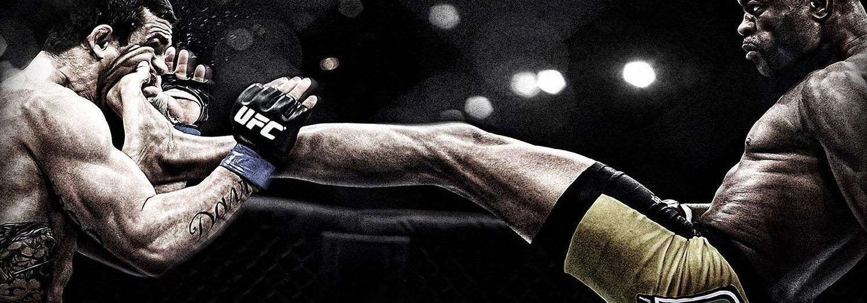
UFC DATASET ANALYSIS

Slide 2

• 862 Features
• 2318 observations
•Data from 2013-2017
•842 have fought on blue corner
• 949 have fought on red corner
Notes:
• Datos NA
• Columna Age, height imputadas por la media
• Columna Weight, Location, HomeTown imputadas por la moda

Slide 3
Which fighters had the most amounts of fights?

Slide 4
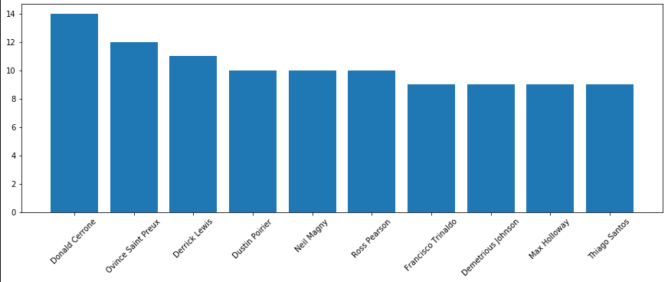
Fighters on the red corner

Slide 5
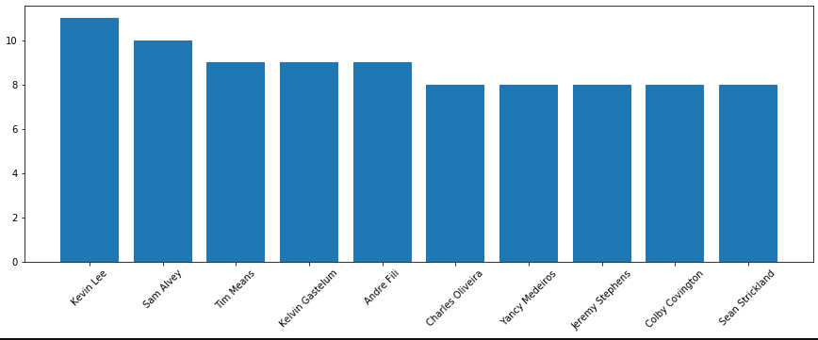
Fighters on the blue corner

Slide 6
When does fighters are at their prime?

Slide 7
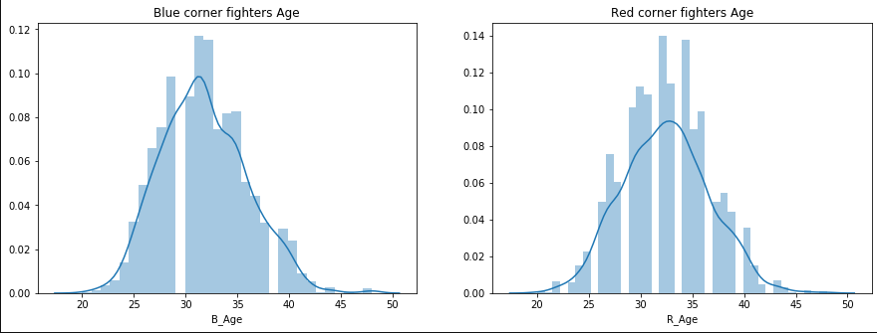
Fighters Age by corner

Slide 8
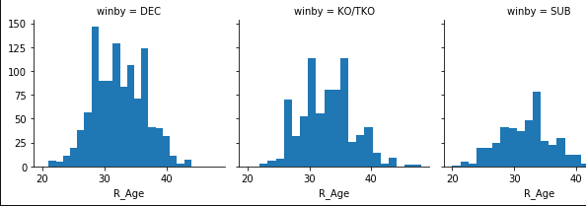
Fighters Age when winning in red corner

Slide 9
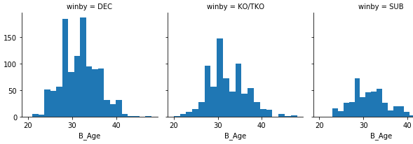
Fighters Age when winning in blue corner

Slide 10
How does weight class can impact in the fight?

Slide 11
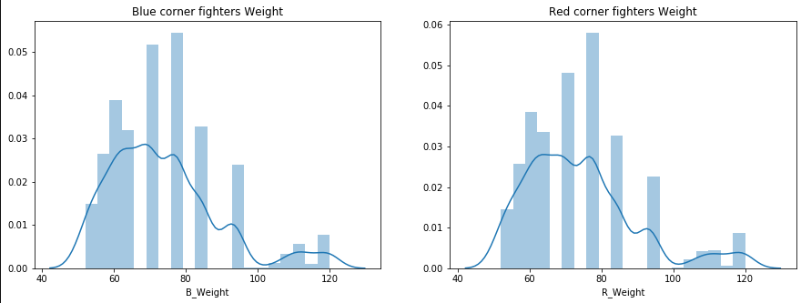
Fighters weight by corner

Slide 12
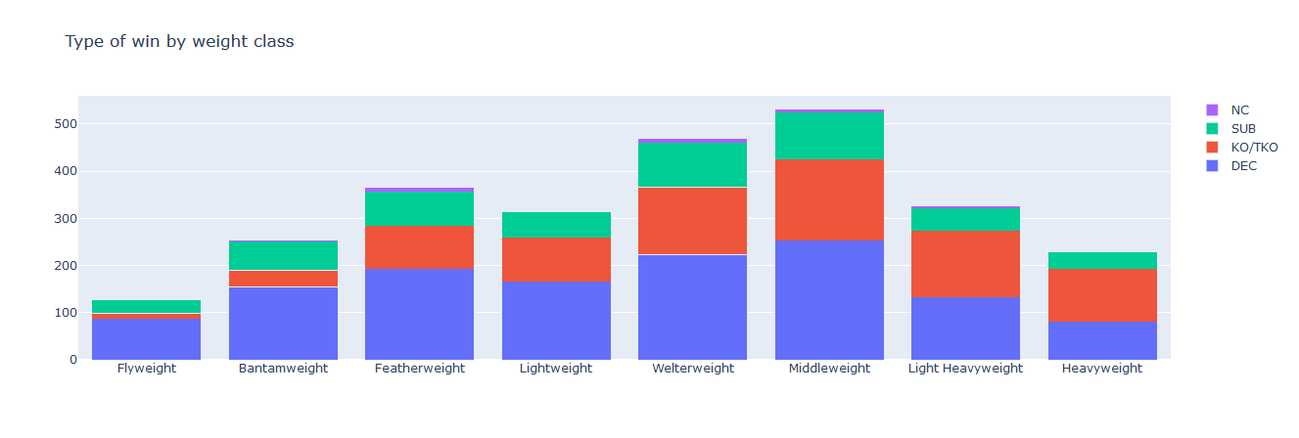
Type of win by weight class

Slide 13
Which is the most popular way of finalization?

Slide 14
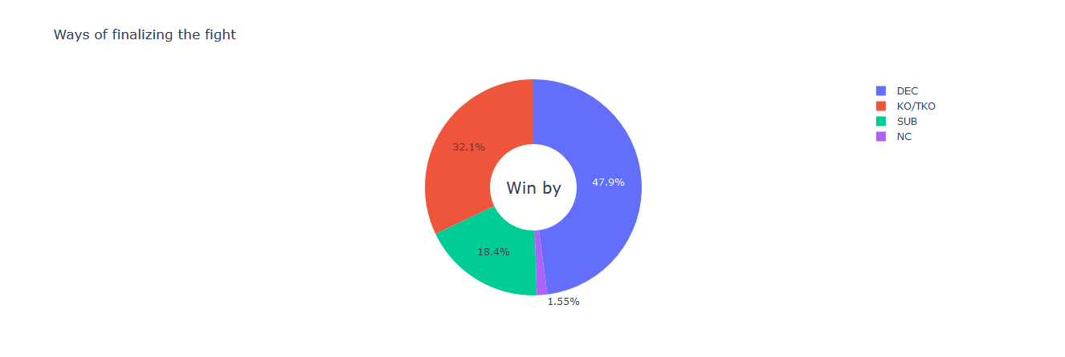
Ways of finalizing the fight

Slide 15
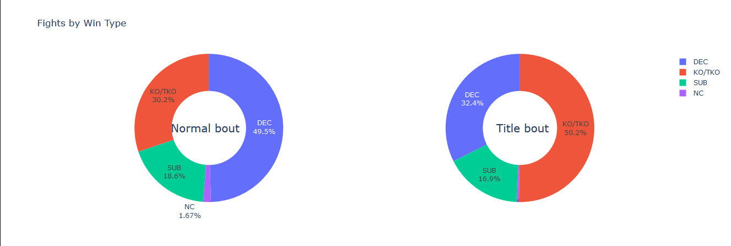
Difference in finalizations between title and normal bouts

Slide 16
Clusterize fighters by fighting style

Slide 17
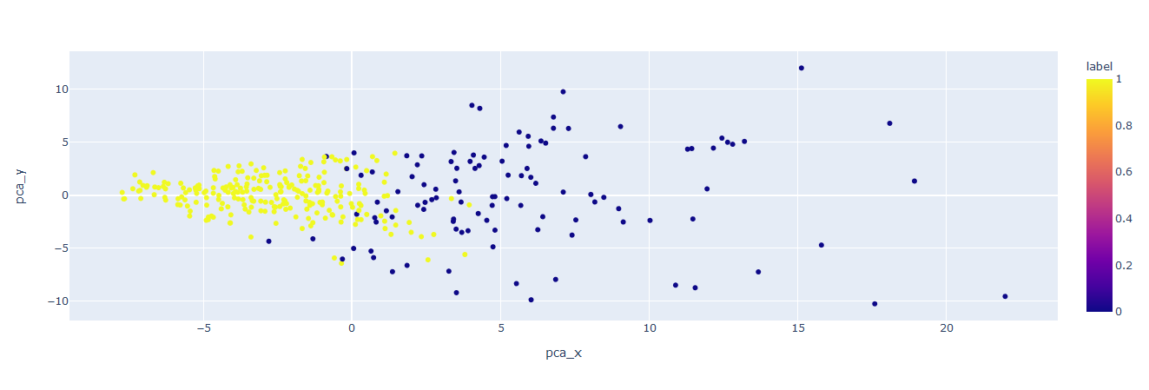

Slide 18
Does head strikes influence in the match result?

Slide 19
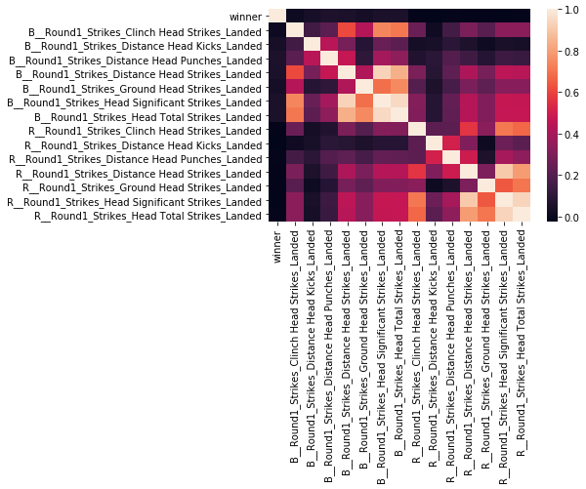
round 1 landed head strikes

Slide 20
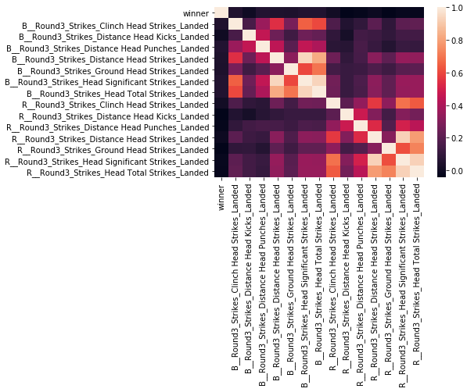
round 3 landed head strikes

Slide 21
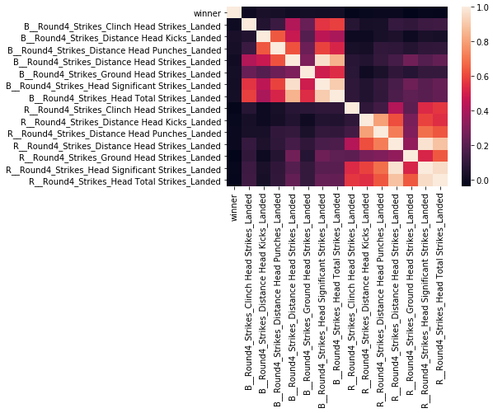
round 5 landed head strikes

Slide 22
thanks

